Slide 1
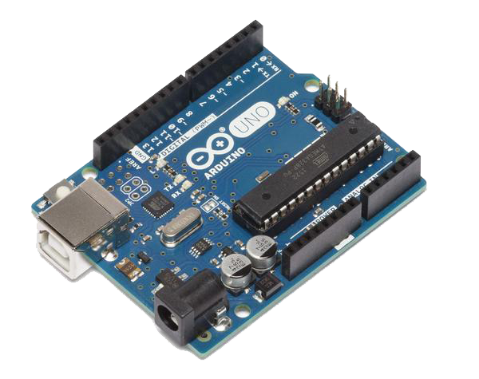
Introduction to Arduino Space Apps 2018 Data Bootcamp
Instructor: Andrew Denio

Slide 2
Overview
Who is Arduino and What Does He Do?
Arduino and Space Apps
Parts, Tools, and Equipment
Integrated Development Environment
Example Sketches (aka code/programs/apps)
Fun with LEDs!

Slide 3


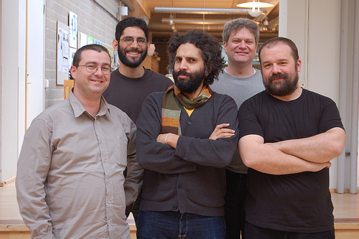
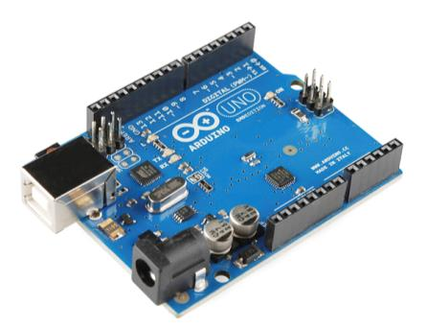
Who is Arduino and What Does He Do?
“Strong Friend” Created in Ivrea, Italy in 2005 by Massimo Banzi & David Cuartielles
Open Source Hardware
Processor
Coding is accessible & transferrable (C++, Processing, java)

Slide 4
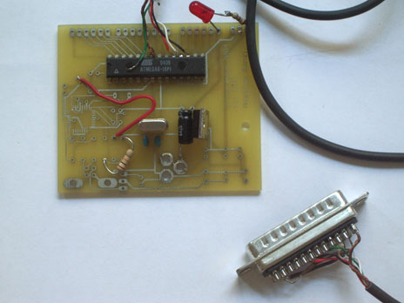
Go-to gear for artists, hobbyists, students, and anyone with a gadgetry dream.
Rose out of another formidable challenge: how to teach students to create electronics, fast.
First prototype in 2005

Slide 5

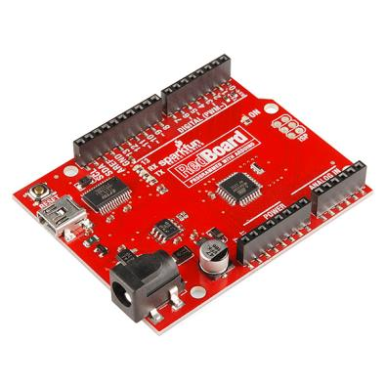
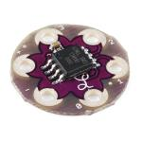
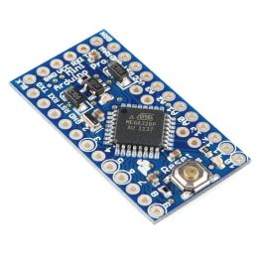
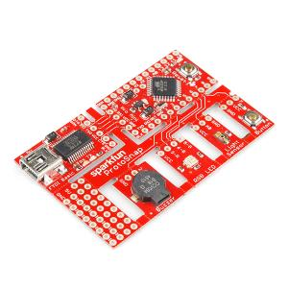
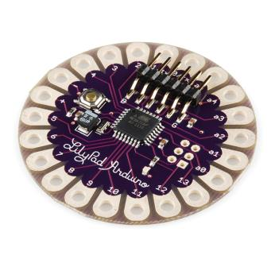
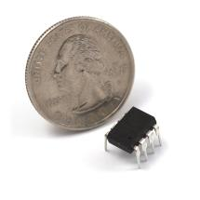
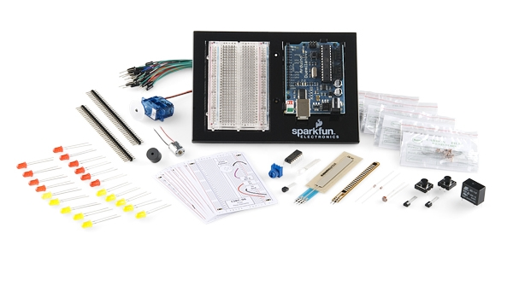
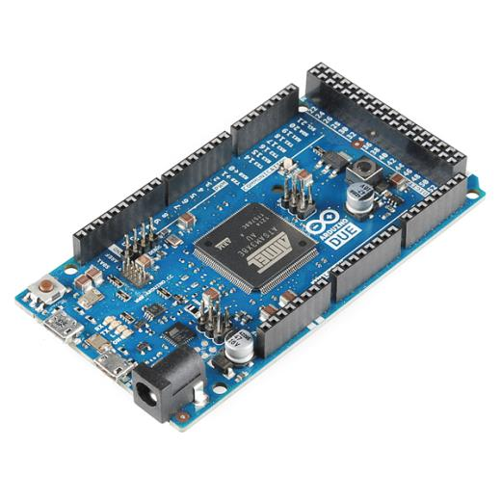
Arduino & Arduino Compatible Boards

Slide 6
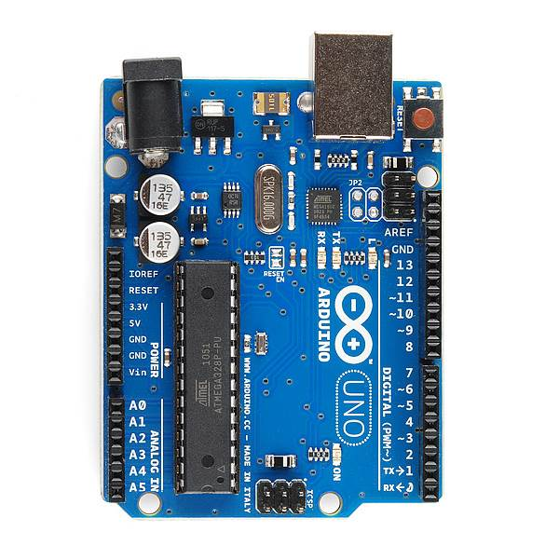
PWR IN
USB
(to Computer)
RESET
SCL\SDA
(I2C Bus)
POWER
5V / 3.3V / GND
Digital I\O
PWM(3, 5, 6, 9, 10, 11)
Analog INPUTS
Notes:
Look up analog ref

Slide 7
Why Arduino for Space Apps?
You’ll become a better programmer
You’ll learn a lot about electronics
Software + Hardware is cooler than Software
After Space Apps, make cool projects!
Global Awards:
Best Use of Data
Best Use of Hardware
Best Mission Concept*
Galactic Impact
Most Inspirational
* proven

Slide 8
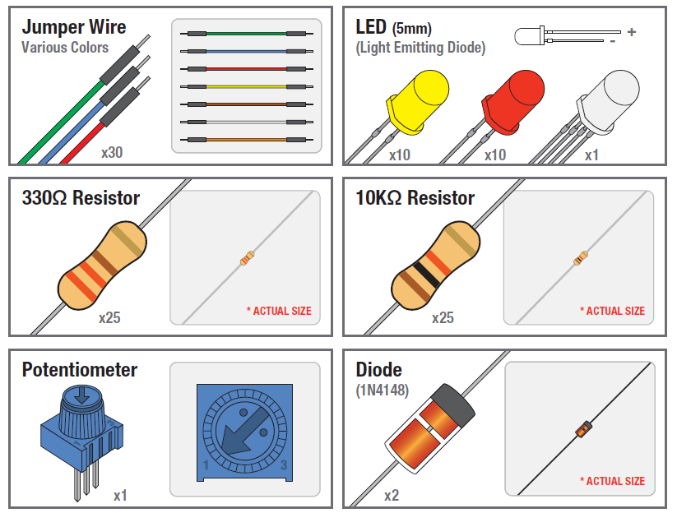
Parts, Tools, Equipment

Slide 9
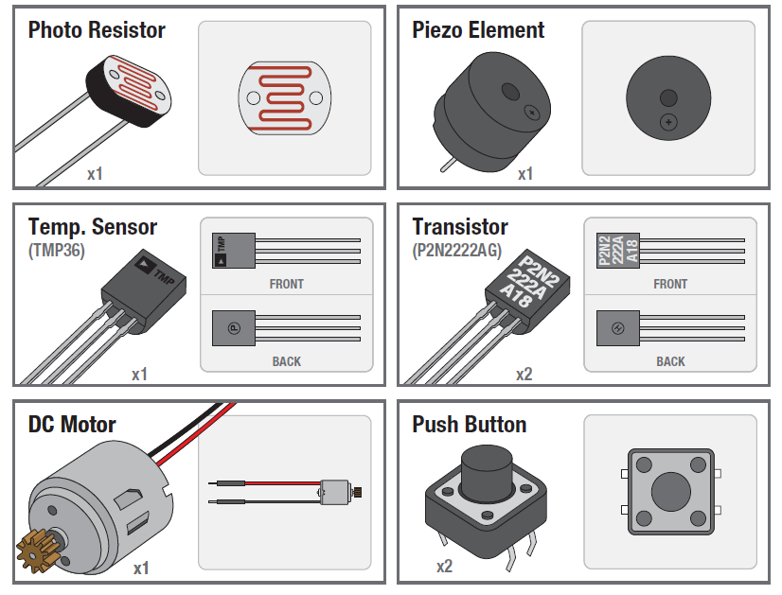

Slide 10
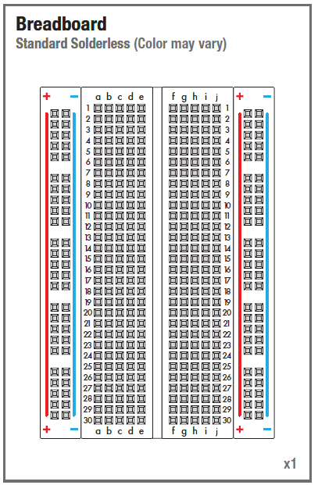
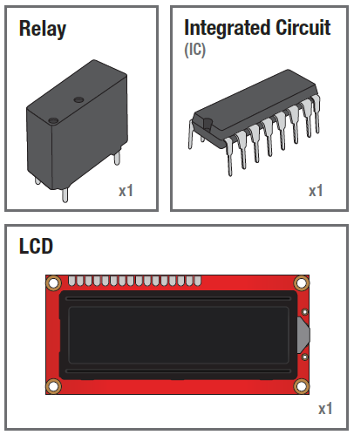

Slide 11
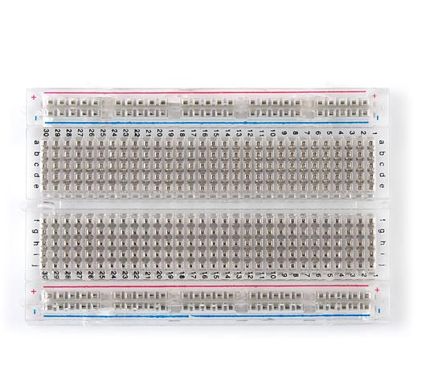
Solderless Breadboard
One of the most useful tools in an engineer or Maker’s toolkit. The three most important things:
A breadboard is easier than soldering
A lot of those little holes are connected, which ones?
Sometimes breadboards break
Each row (horiz.) of 5 holes are connected.
Vertical columns – called power bus are connected vertically

Slide 12
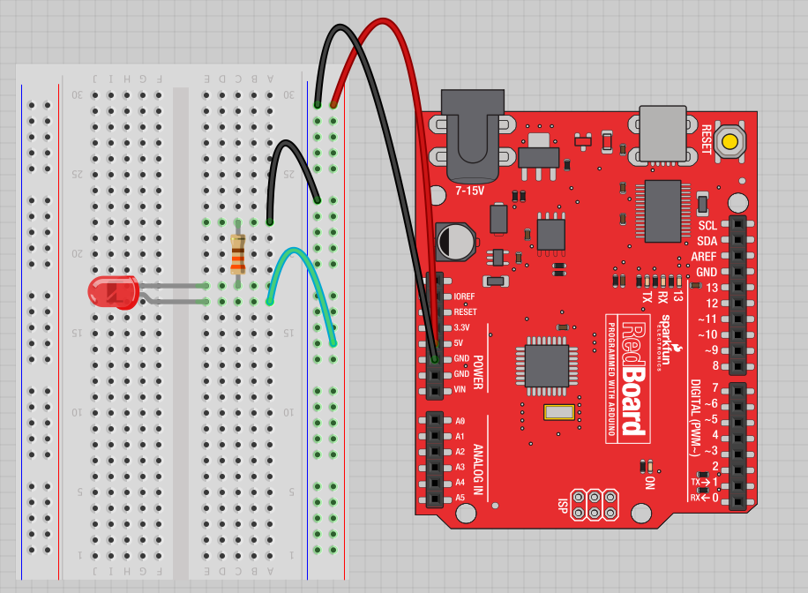
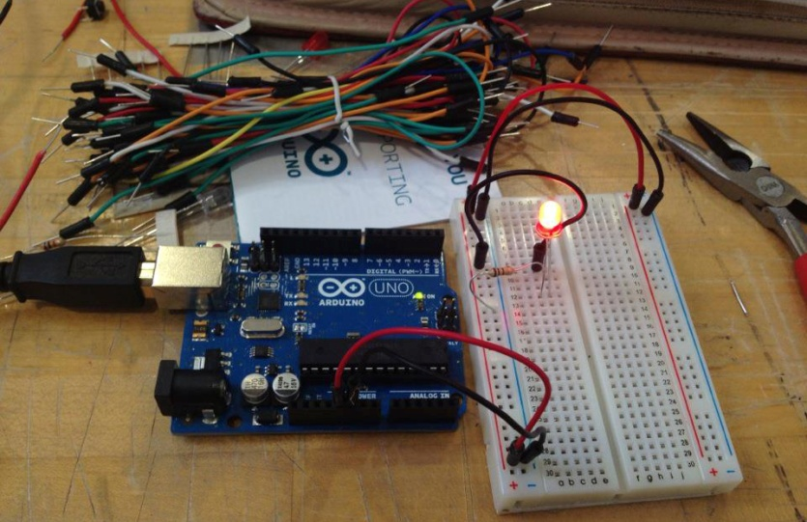
Fritzing View of Breadboard Circuit
What happens when you break the circuit?
What if you wanted to add more than one LED?

Slide 13
Concepts: INPUT vs. OUTPUT
Referenced from the perspective of the microcontroller (electrical board).
Inputs is a signal / information going into the board.
Output is any signal exiting the board.
Examples: Buttons Switches, Light Sensors, Flex Sensors, Humidity Sensors, Temperature Sensors…
Examples: LEDs, DC motor, servo motor, a piezo buzzer, relay, an RGB LED

Slide 14
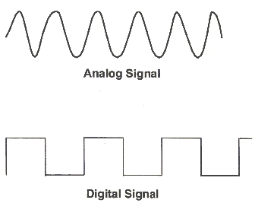
Concepts: Analog vs. Digital
Microcontrollers are digital devices – ON or OFF. Also called – discrete.
analog signals are anything that can be a full range of values. What are some examples? More on this later…
5 V
5 V
0 V
0 V

Slide 15

Open up Arduino
Hints:
For PC Users →
Let the installer copy and move the files to the appropriate locations, or
Create a folder under C:\Program Files (x86) called Arduino. Move the entire Arduino program folder here.
For Mac Users →
Move the Arduino executable to the dock for ease of access.
Resist the temptation to run these from your desktop.

Slide 16

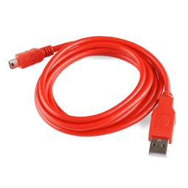
Go ahead and plug your board in!

Slide 17
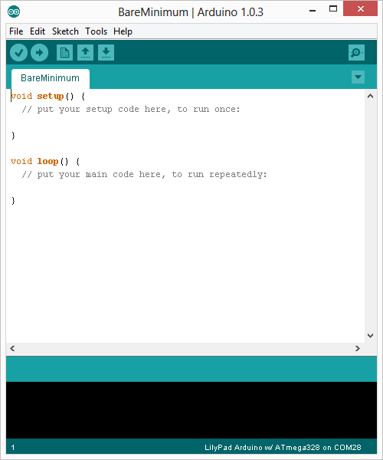
Integrated Development Environment (IDE)
Two required functions / methods / routines:
void setup()
{
// runs once
}
void loop()
{
// repeats
}
error & status messages

Slide 18
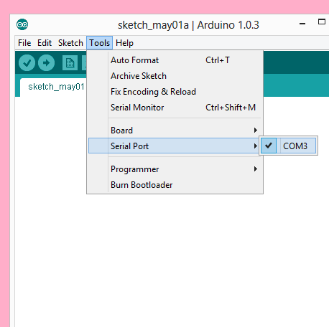
Your computer communicates to the Arduino microcontroller via a serial port → through a USB-Serial adapter.
Check to make sure that the drivers are properly installed.

Slide 19
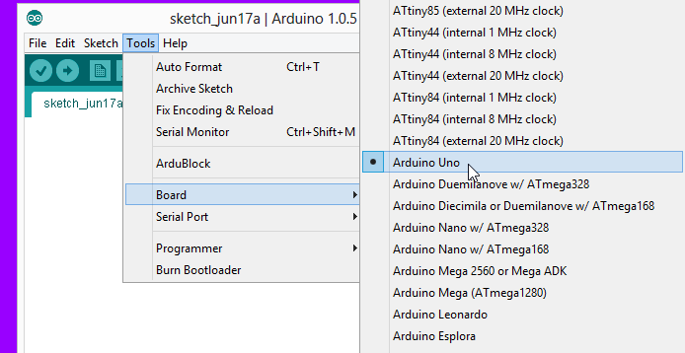
Settings: Tools → Board
Next, double-check that the proper board is selected under the Tools→Board menu.

Slide 20
Let’s get to coding…
Project #1 – Blink
“Hello World” of Physical Computing
Psuedo-code – how should this work?
Turn LED ON
Wait
Turn LED OFF
Wait
Rinse & Repeat

Slide 21
Comments, Comments, Comments
Comments are for you – the programmer and your friends…or anyone else human that might read your code.
// this is for single line comments
// it’s good to put a description at the top and before anything ‘tricky’
/* this is for multi-line comments
Like this…
And this….
*/

Slide 22
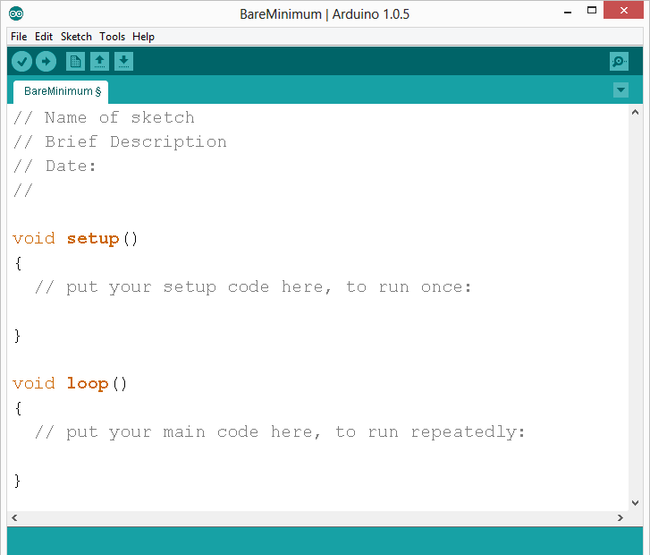
comments

Slide 23
Three commands to know…
pinMode(pin, INPUT/OUTPUT);
ex: pinMode(13, OUTPUT);
digitalWrite(pin, HIGH/LOW);
ex: digitalWrite(13, HIGH);
delay(time_ms);
ex: delay(2500); // delay of 2.5 sec.
// NOTE: -> commands are CASE-sensitive

Slide 24
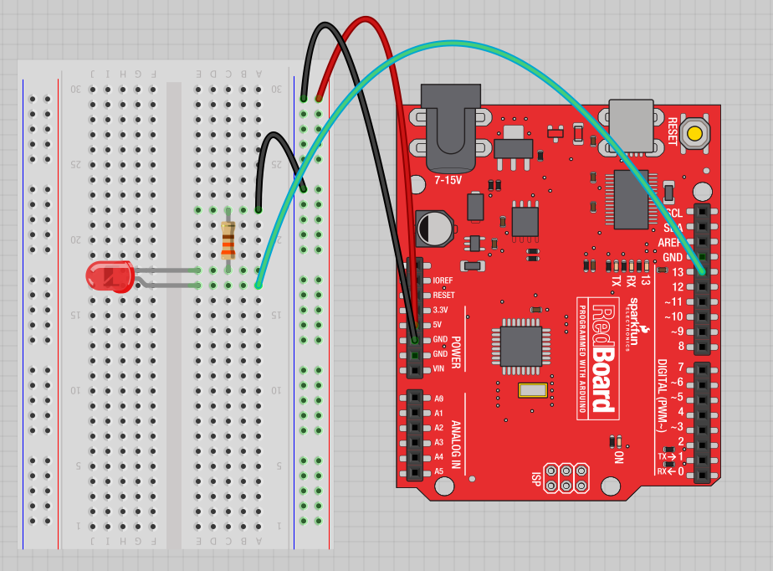
Project #1: Wiring Diagram
Move the green wire from the power bus to pin 13 (or any other Digital I/O pin on the Arduino board.
Image created in Fritzing

Slide 25
A few simple challenges Let’s make LED#13 blink!
Challenge 1a – blink with a 200 ms second interval.
Challenge 1b – blink to mimic a heartbeat
Challenge 1c – find the fastest blink that the human eye can still detect…
1 ms delay? 10 ms delay? 20 ms delay? 30 ms delay???

Slide 26
Try adding other LEDs
Try the following extra projects at home:
Can you blink two, three, or four LEDs? (Hint: Each LED will need it’s own resistor)
Generate your own morse code flashing
How about a Knight Rider, Disco, or Police Light?

Slide 27
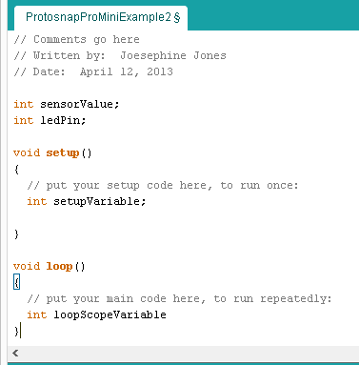
Programming Concepts: Variables
Variable Scope
Global
---
Function-level

Slide 28



Programming Concepts: Variable Types
Variable Types:
8 bits
16 bits
32 bits
byte
char
int
unsigned int
long
unsigned long
float

Slide 29
Fading in and Fading Out (Analog or Digital?)
A few pins on the Arduino allow for us to modify the output to mimic an analog signal.
This is done by a technique called:
Pulse Width Modulation (PWM)

Slide 30
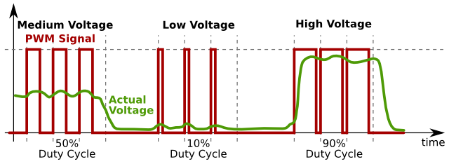
Concepts: Analog vs. Digital
To create an analog signal, the microcontroller uses a technique called PWM. By varying the duty cycle, we can mimic an “average” analog voltage.
Pulse Width Modulation (PWM)

Slide 31

Project #2 – Fading Introducing a new command…
analogWrite(pin, val);
pin – refers to the OUTPUT pin (limited to pins 3, 5, 6, 9, 10, 11.) – denoted by a ~ symbol
val – 8 bit value (0 – 255).
0 => 0V | 255 => 5V

Slide 32
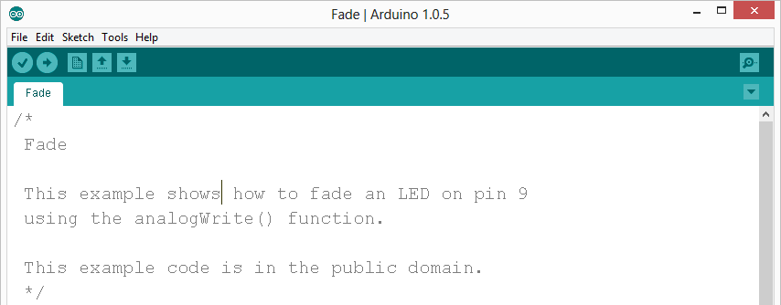
Move one of your LED pins over to Pin 9
In Arduino, open up:
File → Examples → 01.Basics → Fade

Slide 33
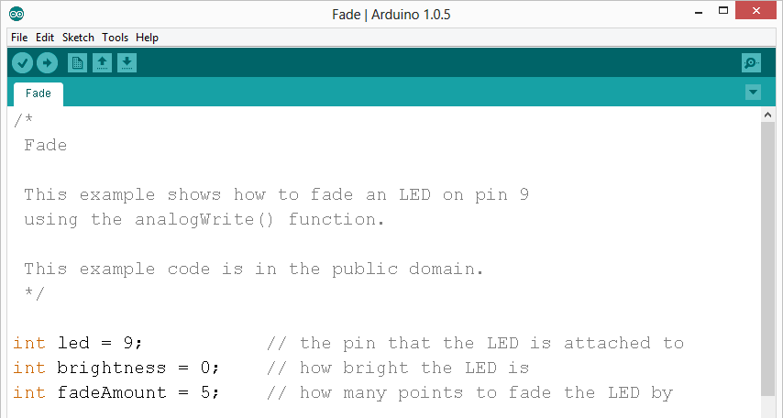
Fade - Code Review

Slide 34
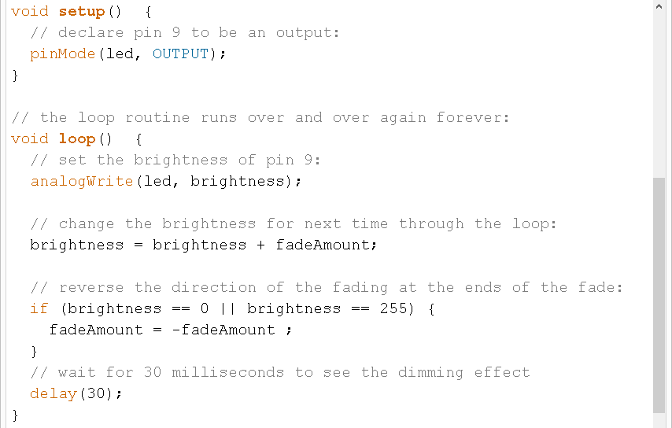
Fade - Code Review

Slide 35
Project# 2 -- Fading
Challenge 2a – Change the rate of the fading in and out. There are at least two different ways to do this – can you figure them out?
Challenge 2b – Use 2 (or more) LEDs – so that one fades in as the other one fades out.
Challenge 2c – Use a red and blue LEDs to create a “police light” effect.

Slide 36
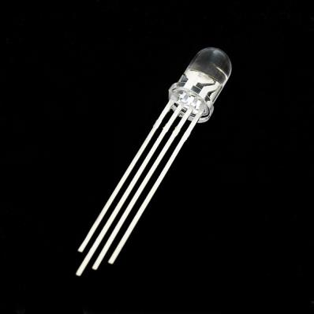
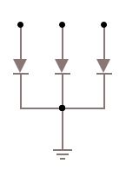
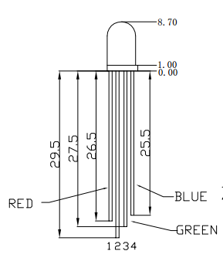
Color Mixing Tri-color LED
R
G
B
In the SIK, this is a standard – Common Cathode LED
This means the negative side of the LED is all tied to Ground.

Slide 37
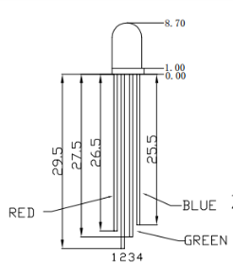
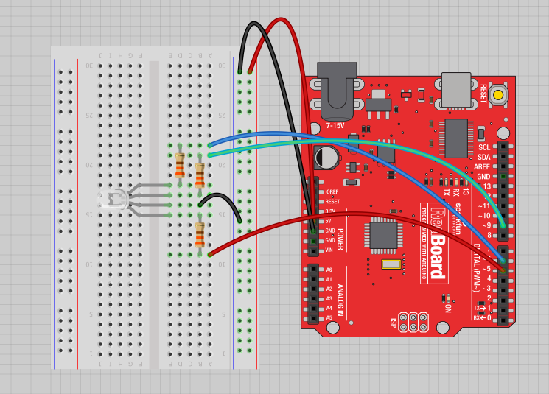
Project 3 – RGB LED
Note: The longest leg of the RGB LED is the Common Cathode. This goes to GND.
Use pins 5, 6, & 9

Slide 38

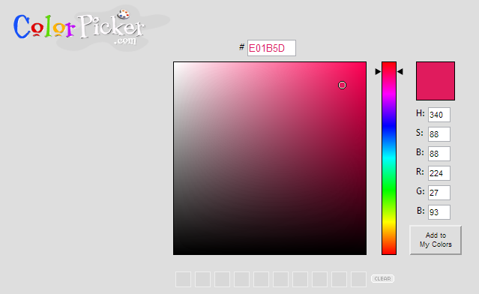
How many unique colors can you create?
Use Colorpicker.com or experiment on your own.
Pick out a few colors that you want to try re-creating for a lamp or lighting display...
Play around with this with the analogWrite() command.

Slide 39
RGB LED Color Mixing – Challenge 3a
int redPin = 5;
int greenPin = 6;
int bluePin = 9;
void setup()
{
pinMode(redPin, OUTPUT);
pinMode(greenPin, OUTPUT);
pinMode(bluePin, OUTPUT);
}

Slide 40
RGB LED Color Mixing – Challenge 3a
void loop()
{
analogWrite(redPin, 255);
analogWrite (greenPin, 255);
analogWrite (bluePin, 255);
}

Slide 41
Project# 3 – RGB LEDs
Challenge 3a – Hookup RGB LED to pins 5,6,9 and the longest pin on the LED in series with a 220 ohm resistor then connected to the GND rail on the breadboard.
Uploade the example code, find out which pins are red, green, blue, and change values to brightness as desired.

Slide 42
Coding Basics Exploring code and communication

Slide 43
Overview
Variables, Statements, Loops, and Functions
Serial Communication
Nerd Texting
Piezo Buzzers

Slide 44
Programming Concepts: Variables
Variable Scope
Global
---
Function-level

Slide 45
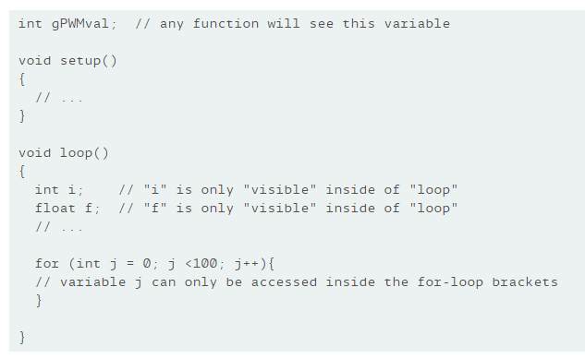
Scope

Slide 46
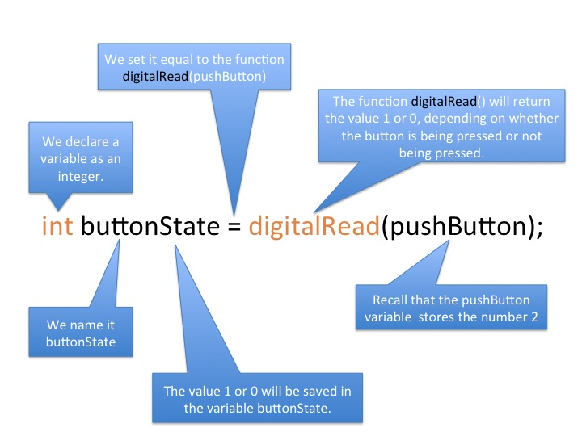

Slide 47
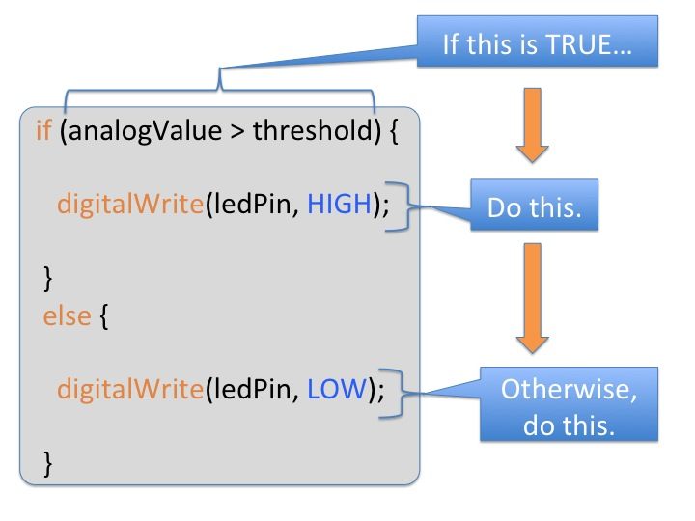
Programming: Conditional Statements if()

Slide 48
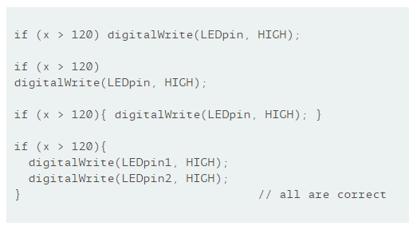
Programming: Conditional Statements if()

Slide 49
Boolean Operators
<Boolean> | Description
( ) == ( ) | is equal?
( ) != ( ) | is not equal?
( ) > ( ) | greater than
( ) >= ( ) | greater than or equal
( ) < ( ) | less than
( ) <= ( ) | less than or equal

Slide 50
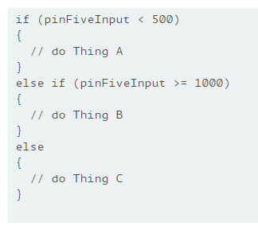

Slide 51
For Loops
The for statement is used to repeat a block of statements enclosed in curly braces. An increment counter is usually used to increment and terminate the loop. The for statement is useful for any repetitive operation, and is often used in combination with arrays to operate on collections of data/pins.
There are three parts to the for loop header:
for (initialization; condition; increment) {
//statement(s); }

Slide 52
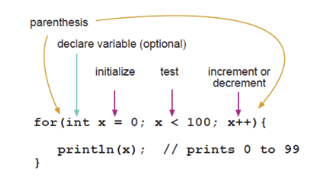
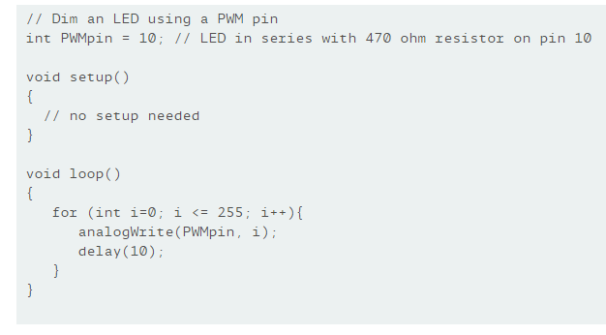

Slide 53
While Loops
while loops will loop continuously, and infinitely, until the expression inside the parenthesis, () becomes false. Something must change the tested variable, or the while loop will never exit. This could be in your code, such as an incremented variable, or an external condition, such as testing a sensor.
var = 0; while(var < 200){ // do something repetitive 200 times var++; }

Slide 54
Functions
Segmenting code into functions allows a programmer to create modular pieces of code that perform a defined task and then return to the area of code from which the function was "called". The typical case for creating a function is when one needs to perform the same action multiple times in a program. var FunctionName(param1, param2){
//do some stuff return result; }

Slide 55
Functions
Functions help the programmer stay organized. Often this helps to conceptualize the program.
Functions codify one action in one place so that the function only has to be thought out and debugged once.
This also reduces chances for errors in modification, if the code needs to be changed.
Functions make the whole sketch smaller and more compact because sections of code are reused many times.
They make it easier to reuse code in other programs by making it more modular, and as a nice side effect, using functions also often makes the code more readable.

Slide 56
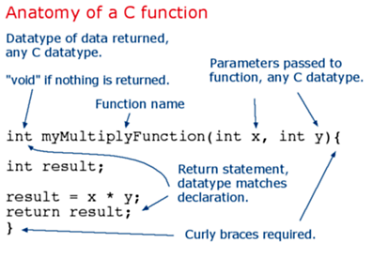
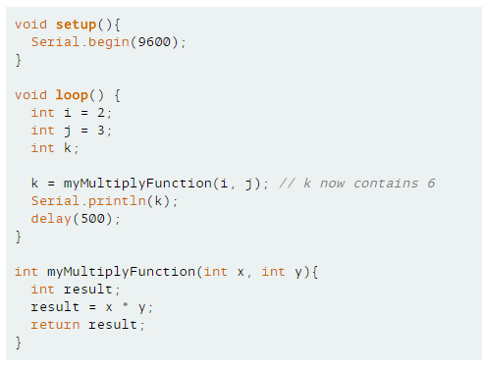
Functions

Slide 57
Project# 4 – Fading using For Loop
Challenge 4a – use a for loop instead to fade up and down the led
There is more than one way to code this

Slide 58
Serial Communication
Serial communication on pins TX/RX uses TTL logic levels (5V or 3.3V depending on the board). Don't connect these pins directly to an RS232 serial port; they operate at +/- 12V and can damage your Arduino board.
Serial is used for communication between the Arduino board and a computer or other devices. All Arduino boards have at least one serial port (also known as a UART or USART): Serial. It communicates on digital pins 0 (RX) and 1 (TX) as well as with the computer via USB. Thus, if you use these functions, you cannot also use pins 0 and 1 for digital input or output.

Slide 59
Serial Communication
You can use the Arduino environment's built-in serial monitor to communicate with an Arduino board. Click the serial monitor button in the toolbar and select the same baud rate used in the call to begin().

Slide 60
Serial Communication
Open the Basics > Digital Read Serial example
Connect a jumper wire to Pin 2. After starting the program, open the serial monitor and switch the other side of the jumper wire from the GND port to the 5V port.
What do you notice when switching back and forth?

Slide 61
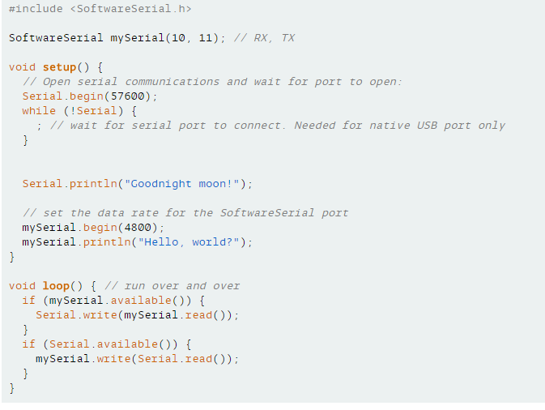
Software Serial
Allows for more serial ports

Slide 62
Project #5 – Nerd Texting
Use Serial Communication to talk with your friend
Open the SoftwareSerial > SoftwareSerialExample program
Change Baud rate to 9600 for both Serial and Software Serial
Connect jumper wires to pins 10/11 (reverse for friend)
In Serial Monitor, choose 9600 Baud and Newline
Type messages in the input box and hit send

Slide 63
Piezo Buzzer and tone()
Generates a square wave of the specified frequency (and 50% duty cycle) on a pin. A duration can be specified, otherwise the wave continues until a call to noTone(). The pin can be connected to a piezo buzzer or other speaker to play tones.
Only one tone can be generated at a time. If a tone is already playing on a different pin, the call to tone() will have no effect. If the tone is playing on the same pin, the call will set its frequency.
Use of the tone() function will interfere with PWM output on pins 3 and 11 (on boards other than the Mega).

Slide 64
Project #6 – Piezo Tone
Challenge 6a – Hook up piezo buzzer to pin 8. Make sure the longer lead is the pin going to 8. The shorter one should go to GND. Open the challenge 6a example and play around with it.
Explore the different tone examples in the “digital” library examples

Slide 65
Sensors how robots sense the environment

Slide 66
Overview
What are sensors and why do we need them
Tilt Sensor
Light Sensor
Ultrasonic Distance (Ping) Sensor

Slide 67

Sensors

Slide 68
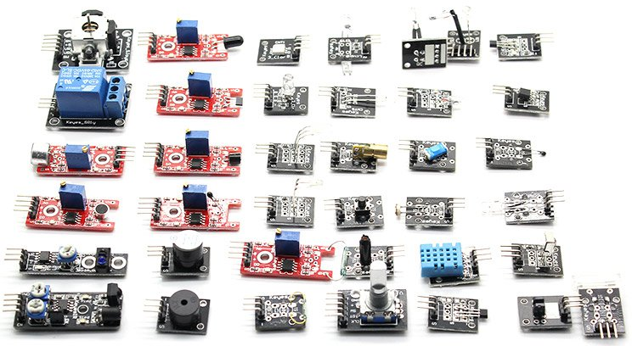
A sensor is a device that detects and responds to some type of input from the physical environment. The specific input could be light, heat, motion, moisture, pressure, or any one of a great number of other environmental phenomena.

Slide 69
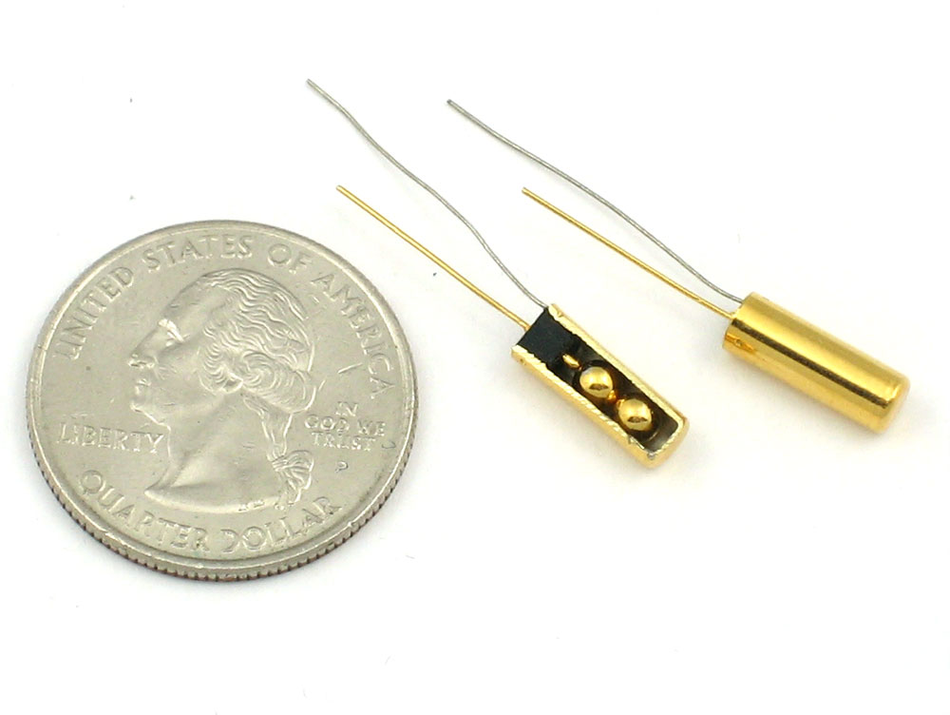
Tilt Sensor

Slide 70
Tilt Sensor
Tilt sensors allow you to detect orientation or inclination. They are small, inexpensive, low-power and easy-to-use. If used properly, they will not wear out. Their simplicity makes them popular for toys, gadgets and appliances. Sometimes they are referred to as "mercury switches", "tilt switches" or "rolling ball sensors" for obvious reasons.
They are usually made by a cavity of some sort (cylindrical is popular, although not always) and a conductive free mass inside, such as a blob of mercury or rolling ball. One end of the cavity has two conductive elements (poles). When the sensor is oriented so that that end is downwards, the mass rolls onto the poles and shorts them, acting as a switch throw.

Slide 71

Testing a Tilt Sensor

Slide 72



Tilt Sensor – TiltSwitchLED Code

Slide 73
Project #7 – Tilt Switch and LED
Challenge 7a – Use a 10 kOhm resistor to create a “pull-up resistor.” Run a jumper wire from pin 2 to tilt switch, and place the resistor in the circuit going to the 5V rail. Connect another jumper wire from the other Tilt Switch pin to the GND rail on the breadboard.
Open the example, upload code, and play with the circuit. LED should turn off when tipped upside down.

Slide 74

Light Sensor / Photocell

Slide 75
Photocells are sensors that allow you to detect light. They are small, inexpensive, low-power, easy to use and don't wear out. For that reason they often appear in toys, gadgets and appliances. They are often referred to as CdS cells (they are made of Cadmium-Sulfide), light-dependent resistors (LDR), and photoresistors.
Photocells are basically a resistor that changes its resistive value (in ohms Ω) depending on how much light is shining onto the squiggly face. They are very low cost, easy to get in many sizes and specifications, but are very inaccurate. Each photocell sensor will act a little differently than the other, even if they are from the same batch. The variations can be really large, 50% or higher! For this reason, they shouldn't be used to try to determine precise light levels in lux or millicandela. Instead, you can expect to only be able to determine basic light changes.

Slide 76

Light Sensor

Slide 77

Testing a Light Sensor

Slide 78


LightSensor Code

Slide 79
Project #8 – Light Sensor and LED
Challenge 8a – Use a 10 kOhm resistor to create a “pull-down resistor.” Run a jumper wire from pin A0 to light sensor, and place the resistor in the circuit going to the GND rail. Connect another jumper wire from the other light sensor pin to the 5V rail on the breadboard. Connect positive lead of LED to pin 11.
Open the example, upload code, open Serial Monitor, and play with the circuit. Try adjusting the ambient light around the sensor. Cover it with your hand, use your phone’s light, etc.

Slide 80

Ultrasonic Distance Sensor

Slide 81
Ultrasonic Distance Sensor
The HC-SR04 is an ultrasonic ranging sensor. This economical sensor provides 2cm to 400cm of non-contact measurement functionality with a ranging accuracy that can reach up to 3mm. Each HC-SR04 module includes an ultrasonic transmitter, a receiver and a control circuit.
There are four pins on the HC-SR04:
VCC (Power), Trig (Trigger), Echo (Receive), and GND
(Ground).

Slide 82

Ultrasonic Distance Sensor

Slide 83

PingSensor Code

Slide 84
Project #9 – Ping Sensor
Challenge 9a – Connect VCC pin to 5V rail, GND pin to GND rail, trigger pin to Arduino pin 12, echo pin to Arduino pin 11.
Open the example, upload code, open Serial Monitor, and play with the sensor.
Challenge 9b – Hook up piezo buzzer to pin 8. Open 9b example and play around with it.

Slide 85
Buttons and Switches turning wires into keyboards

Slide 86
Overview
Slide Switch
Momentary Buttons

Slide 87

Buttons and Switches

Slide 88
Buttons and Switches are digital inputs that are very useful in the Arduino world. They can be used to turn things on, off, or send commands. They can also be thought of as a digital sensor with two possible states.
One of the most elementary and easy-to-overlook circuit component is the switch.
Switches don’t require any fancy equations to evaluate. All they do is select between an open circuit and a short circuit. Simple. But how could we live without buttons and switches!? What good is a blinky circuit with no user input? Or a deadly robot with no kill switch? What would our world be without with big red buttons you should never, ever press.

Slide 89
A switch controls the open-ness or closed-ness of an electric circuit. They allow control over current flow in a circuit (without having to actually get in there and manually cut or splice the wires). Switches are critical components in any circuit which requires user interaction or control.
A switch can only exist in one of two states: open or closed. In the off state, a switch looks like an open gap in the circuit. This, in effect, looks like an open circuit, preventing current from flowing.
In the on state, a switch acts just like a piece of perfectly-conducting wire. A short. This closes the circuit, turning the system “on” and allowing current to flow unimpeded through the rest of the system

Slide 90
Switch actuation can come from pushing, sliding, rocking, rotating, throwing, pulling, key-turning, heating, magnetizing, kicking, snapping, licking,…any physical interaction which can cause the mechanical linkages inside the switch to come into, or go out of, contact.
All switches fall into one of two distinct categories: momentary or maintained.
Maintained switches – like the light switches on your wall – stay in one state until actuated into a new one, and then remain in that state until acted upon once again. These switches might also be called toggle or ON/OFF switches.
Momentary switches only remain active as long as they’re actuated. If they’re not being actuated, they remain in their “off” state. You’ve probably got a momentary switch (or 50) right in front of you…keys on a keyboard!
Semantic alert! Most of the switches we refer to as “buttons” fall in the momentary category. Activating a button usually means pressing down on it in some manner, which just feels like a momentary control. There are such things as a maintained button, but for this tutorial when we slip and talk about “buttons”, think “momentary push-down switch”

Slide 91

Slide Switches

Slide 92
Slide Switches
Need a really basic, no-frills ON/OFF or selector switch? Slide switches might be for you! These switches have a tiny little nub which protrudes from the switch, and it slides across the body into one of two (or more) positions.
You’ll usually find slide switches in SPDT or DPDT configurations. The common terminal is usually in the middle, and the two select positions are on the outside.

Slide 93
Testing a Slide Switch

Slide 94

Slide Switch –SwitchLED Code

Slide 95
Project #10 – Switch and LED
Challenge 10a – Connect one end pin of switch to 10 kOhm resistor and connect those to GND rail. Connect other end of switch with jumper wire to 5V rail. Run jumper wire from middle pin on switch to Arduino pin 2. Hook up LED to Arduino pin 5.
Open the example, upload code, and play with the switch.

Slide 96
Momentary Switches AKA Buttons

Slide 97
Momentary Switches AKA Buttons
Momentary switches are switches which only remain in their on state as long as they’re being actuated (pressed, held, magnetized, etc.). Most often momentary switches are best used for intermittent user-input cases; stuff like reset or keypad buttons.
Push-button switches are the classic momentary switch. Typically these switches have a really nice, tactile, “clicky” feedback when you press them. They come in all sorts of flavors: big, small, colorful, illuminated (when an LED shines up through the button). They might be terminated as through-hole, surface-mount, or even panel-mount.

Slide 98

Momentary Switches AKA Buttons

Slide 99

Buttons – ButtonLED Code

Slide 100
Project #11 – Button and LED
Challenge 11a – Connect pin C of button to 10 kOhm resistor and connect it to GND rail. Connect pin B on button with jumper wire to 5V rail. Run jumper wire from pin D on button to Arduino pin 3. Hook up an LED to Arduino pin 7.
Open the example, upload code, and play with the button.
Challenge 11b – Combine Switch (10a) and Button (11a) codes to have a program to use a button to turn LEDs using both a switch and a button.

Slide 101


Slide 102
Project #12 – Morse Code with Button and Buzzer
Challenge 12a – Connect pin C of button to 10 kOhm resistor and connect it to GND rail. Connect pin B on button with jumper wire to 5V rail. Run jumper wire from pin D on button to Arduino pin 3. Hook up an LED to Arduino pin 7. Hook up piezo buzzer to pin 8.
Open the example, upload code, and play with the button.

Slide 103
Servos I like to move it, move it

Slide 104
Overview
The Sweeping Servo

Slide 105

The Sweeping Servo

Slide 106
The Sweeping Servo
Servo motors are great devices that can turn to a specified position.
Usually, they have a servo arm that can turn 180 degrees. Using the Arduino, we can tell a servo to go to a specified position and it will go there. As simple as that!
Servo motors were first used in the Remote Control (RC) world, usually to control the steering of RC cars or the flaps on a RC plane. With time, they found their uses in robotics, automation, and of course, the Arduino world.
Here we will see how to connect a servo motor and then how to turn it to different positions.

Slide 107

The Sweeping Servo
The position of the servo motor is set by the length of a pulse. The servo expects to receive a pulse roughly every 20 milliseconds. If that pulse is high for 1 millisecond, then the servo angle will be zero, if it is 1.5 milliseconds, then it will be at its centre position and if it is 2 milliseconds it will be at 180 degrees.
The end points of the servo can vary and many servos only turn through about 170 degrees. You can also buy 'continuous' servos that can rotate through the full 360 degrees.

Slide 108


The Sweeping Servo
A servo motor has everything built in: a motor, a feedback circuit, and most important, a motor driver. It just needs one power line, one ground, and one control pin.

Slide 109

The Sweeping Servo
The servo motor has a female connector with three pins. The darkest is usually the ground. The power cable in all standards should be red The remaining line is the signal line, connected to a digital PWM pin on the Arduino.

Slide 110
Project #13 – Servo and Serial
Challenge 13a – Use the following steps to connect a servo motor to the Arduino using jumper wires:
Brown wire – Connect to GND on the Arduino. Red wire - Connect to 5V on the Arduino. Yellow wire - Connect to pin 11 on the Arduino.
Open the example, upload code, and play with the servo using the serial monitor.
Type in a number from 1 to 180 in the input box, hit enter and WATCH MAGIC HAPPEN!!!!

Slide 111
Project #13 – Servo Sweep
Challenge 13b – Use the following steps to connect a servo motor to the Arduino using jumper wires:
Brown wire – Connect to GND on the Arduino. Red wire - Connect to 5V on the Arduino. Yellow wire - Connect to pin 11 on the Arduino.
Open the example, upload code, and WATCH MORE MAGIC HAPPEN!!!!

Slide 112
The End Good luck at Space Apps!!!!

